Slide 1
BE Project: Presentation on, Smart System To Manage The Work Center in Company
By,
Group No: 10
Nilesh Vidhate [A-55]
Ankit Rathod [B-09]
Varun Gunjal [A-05]
Apurv Chavan [B-09]
Guided By
Prof. Atul Chaudhary
Dept. of Computer Engineering

Slide 2
Index
Sponsor details
Overview
Key Issues
Literature Survey
Comparison of algorithm
Problem Statement
Introduction
Architecture
Models
Algorithm
Tungsten Process
Mathematical model
Conclusion
References

Slide 3
Sponsor Details
Company Name: Hindustan Tungsten Carbide.
Plant Location : K5, MIDC Malegaon, Sinnar 422113.
Website : https://htcarb.com/
Contact: 7218672333.

Slide 4
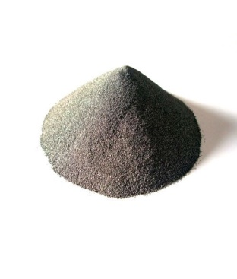
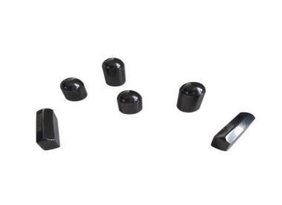
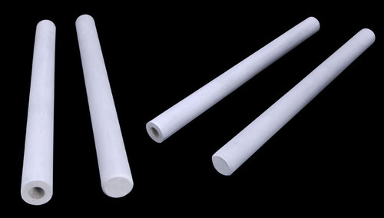
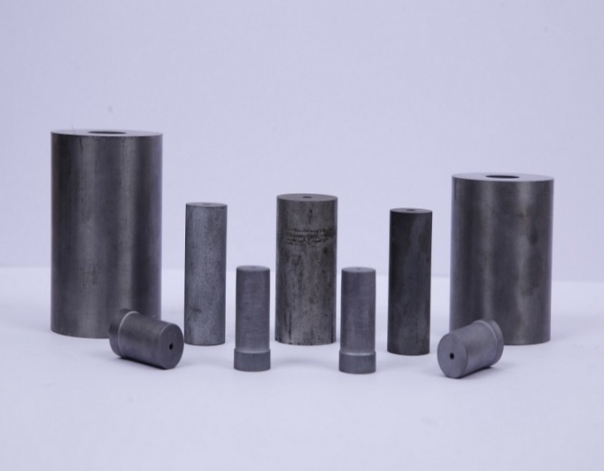
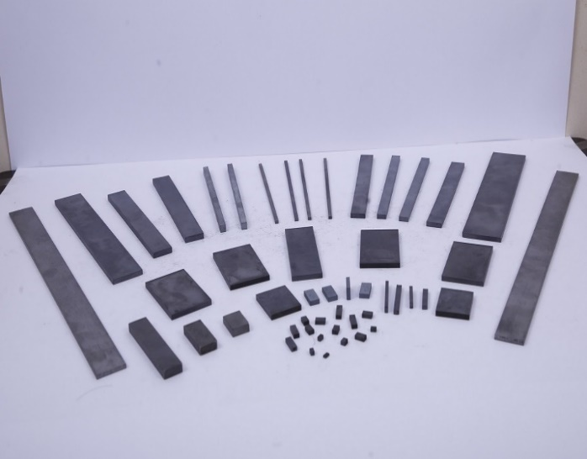
HTC Company Product
Carbide
DS insert
Heading pallets
TC bush
TC flat

Slide 5
Overview
what is cloud computing and web technology?
Cloud computing is the on-demand availability of computer system resources, especially data storage and computing power, without direct active management by the user. Large clouds often have functions distributed over multiple locations, each location being a data center.
Web technologies refers to the way computers/devices communicate. with each other using mark up languages. It inovation It is communication across the web, and create, deliver or manage web content using hypertext markup language (HTML).

Slide 6
Key Issues/Requirement
Issues:
Phase Management.
Record distribution.
Time consuming.

Slide 7
Literature Survey
Sr.no | Title | Author | Published | Year | Technology | Limitation
1 | Policies in Multi-echelon Inventory Systems with Inventory-level-dependent Demand Rate | Dongyi Ma | 6th World Congress on Intelligent Control and Automation | 2019 | swarm optimization algorithm | High Costing and not user friendly
2 | A Secure QR Code System for Sharing Personal Confidential Information | Md. Salahuddin Ahamed , Hossen Asiful Mustafa, Ph.D. | International Conference on Computer, Communication, Chemical, Materials | 2019 | RSA Algorithm | Low Performance

Slide 8
Sr.no | Title | Author | Published | Year | Technology | Limitation
3 | Design and Implementation of an Efficient Elliptic Curve Digital Signature Algorithm (ECDSA) | Yasin Genç , Erkan Afacan | 21 IEEE International IOT, Electronics and Mechatronics Conference (IEMTRONICS) | 978-1) | 2020 | ECDSA | Complex
4 | A SECURE IMAGE STEGANOGRAPHY USING IMPROVED LSB | Lasya Voleti 1 , Balajee R M 2 , Siva Koteswararao Vallep | Proceedings of the International Conference on Artificial Intelligence and Smart Systems | 2021 | LSB | Just a theory

Slide 9
Comparison of algorithm
Sr.No | RSA Algorithm | ESDSA Algorithm | LSB Algorithm
1 | Encryption , Qr code Generation and Scanning | Qr code generation , Digital Signature | Qr code generation
2 | It uses a public key and a private key | It keys derived from elliptic curve cryptography | It uses m-bit pixel method
3 | Easy to implement | Complex to understand and implement | Files are not easily download
4 | Time complexity O(n3) | Time complexity O(n) | Time complexity O(n)
5 | Faster than ESDSA & LSB Algorithm | Slower than RSA but Faster than LSB algorithm | Slower than RSA and ESDSA Algorithm

Slide 10
Problem Statement
The current situation of Hindustan Tungsten Carbide organization is very upset the fundamental issue they are confronting right presently is to oversee records.
Not able to find the phase of particular material of client. Due to which the commitment to client goes fail.

Slide 11
Introduction
We are introducing a smart system which will allows our user to track each and every activity used for building the carbide material, Implementing this system will take Web Technology and My SQL as the technology and database suggested by client.
Our system will be web based which will have different user like super admin, manager, etc. each one will have different user id and password, our system is based on QR code scanning, where user will login to application and scan the QR code based on bin (Container which is user to carry the material) as our system will automatically change the status of building the phase.

Slide 12
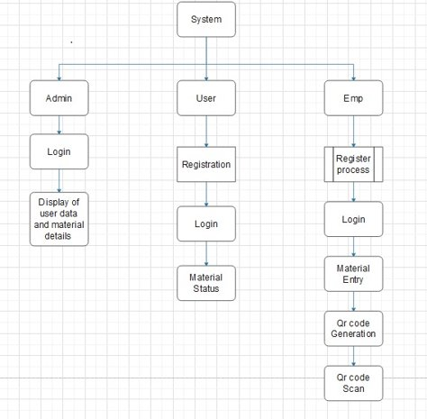
Structural model

Slide 13
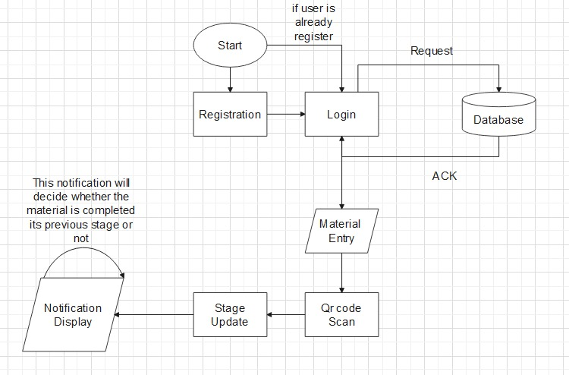
Design Model

Slide 14
Models
Login
QR Code Generation
Material Entry
QR Code scanning
Phase Updating
Model information
Here bootstrap, CSS & Java Script Technology is used.
Here the output will be process and show to user.
RSA algorithm is used to encrypt the data and for validation.
192-bit encryption process will be followed.
MQTT Protocol is used to send the data via internet.
Here the error display is done.
Java is used to build the system.
Display
Errors Noticing
MQTT Protocol is used to send the data via internet.
Here the phase updating process is done.
XML & android is used to build the system.
Here the scanning process is done.
Reed-Solomon error correction is used for scanning the QR code.
Here RSA algorithm will be used for creation of QR code.
We are using Bootstrap and CSS technology for making this model.
Database will be Local like MySQL.
QR code generation process
Here a basic form will be present where information will be filled.
Xml language is used to build this phase.
Database will be MySQL.
Information filling will be done here.
Basically RSA algorithm is used to encrypt the data and for validation.
Here the Authentication process is done.
We are using XML Language.
192-bit encryption process will be followed.

Slide 15
Algorithm
RSA(Rivest–Shamir–Adleman):
The RSA algorithm is an asymmetric cryptography algorithm; this means that it uses a public key and a private key (i.e two different, mathematically linked keys). As their names suggest, a public key is shared publicly, while a private key is secret and must not be shared with anyone.

Slide 16
RSA Algorithm Encryption & Decryption Steps
Key Generation steps and example
1. select 2 large prime number P and Q ; let P=3 and Q=11
2.Calculate n=P*Q ; n=3*11=33
3. calculate Z(n)= (P-1) * (Q-1); Z(n)=2*10=20 (Euler toitien)
4. choose value of e such that should be co-prime
but using condition 1<e<Z(n) and gcd(Z(n),e)=1
ex:- 20=5*2*2 e/20 ≠ 0
so let as assume 7
5. calculate d= e ⁻¹ mod Z(n)
d=7^-1 mod 20
d=3

Slide 17
6. Public key ={e,n};{7,33}
7. Private key ={d,n};{3,33}
Encryption C=M^e mod n
i.e. m<n
M=plain Text
C=Ciper Text
so let assume m= 2
C=2^7 mod 33 = 29
Decryption M=C^d mod n
M = 29^3 mod 33 =2

Slide 18
Steps for QR Generation
Step 1: Enter the confidential information.
Step 2: Each character is converted into ASCII equivalent, then apply
the RSA algorithm for each value with Private key.
Step 3: Generate the code word for the given information by using
non-binary RS code, due to this if the QR is damaged or
distorted it is retrieved.
Step 4: Convert the code word into binary and place these bits in QR
pattern.

Slide 19
Applications of Tungsten Carbide
Tungsten Carbide is used for many applications like following:
Replaceable chip for cutting tools. The chip used for turning or rotary cutting,
Drill for printed circuit board,
End mill,
Molding,
Drill, etc.

Slide 20
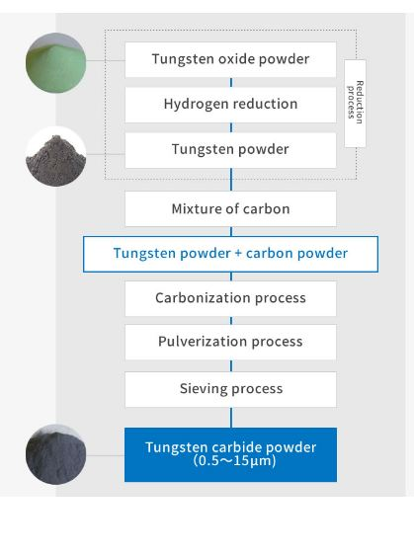
Tungsten Carbide Process
This is the most standard manufacturing method to manufacture tungsten carbide. Making metal tungsten powder and carbon powder chemically-reacted, tungsten carbide is produced.

Slide 21
Software, Hardware Requirement
Software: Notepad ++ (used as Editor),
Xamp 3.4 or high (used for Local Host),
Android Studio 3.1 or above(used for APK design).
Hardware: Processor dual core or high,
Ram 4 GB or high,
Hard Disk 250GB or high,
Qr code Scanner.

Slide 22
Mathematical Model
System Description:
S = (I,O,F)
Where,
S : System
I = {UL, QRG, QRCS} are set of Inputs
Where,
UL: User Login
QRG: QR code Generation
QRCS: Qr code Scan

Slide 23
F = {A, PU} are set of Function
Where,
A: Authentication
PU: Phase Update
O = {N, U} are set of Output
Where,
N: Notification
U: Update
Success Conditions:
Proper database, QR Code Visibility
Failure Conditions:
No database, internet connection

Slide 24
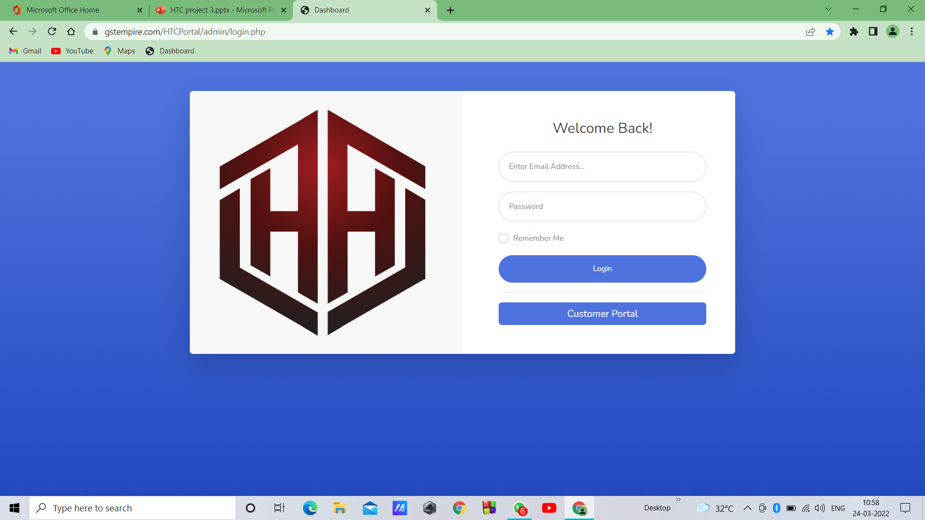
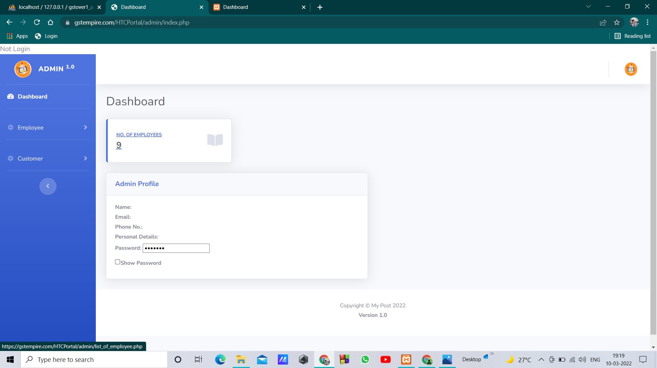
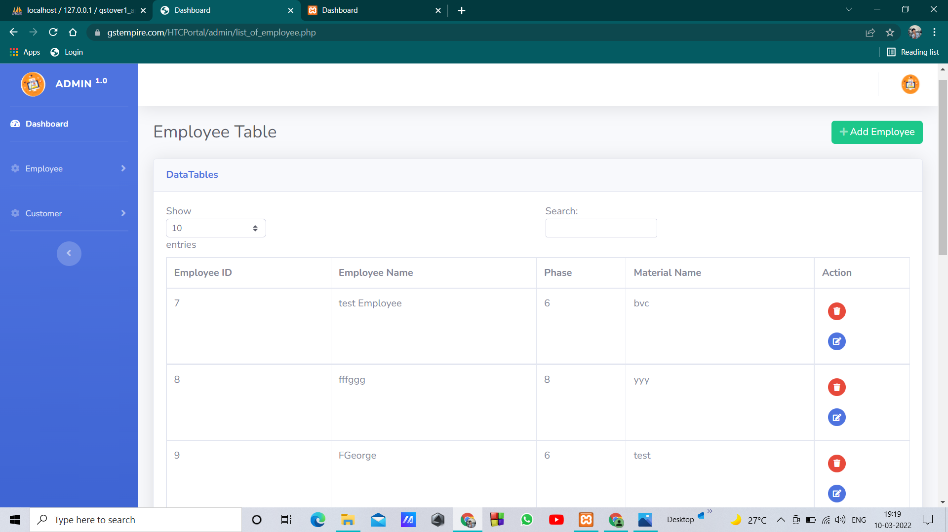
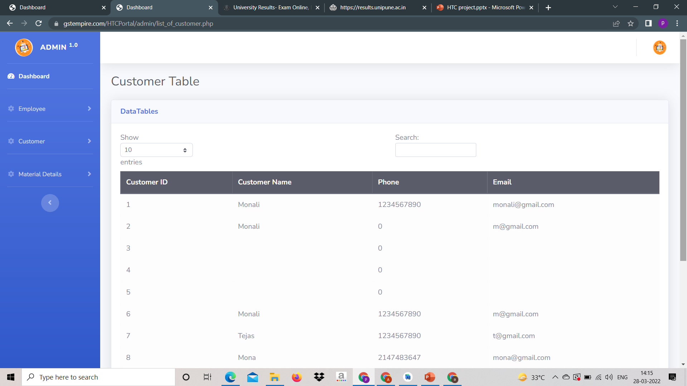
Admin Dashboard
Admin Sign in Page
Admin Dashboard
Employee List
Customer list

Slide 25
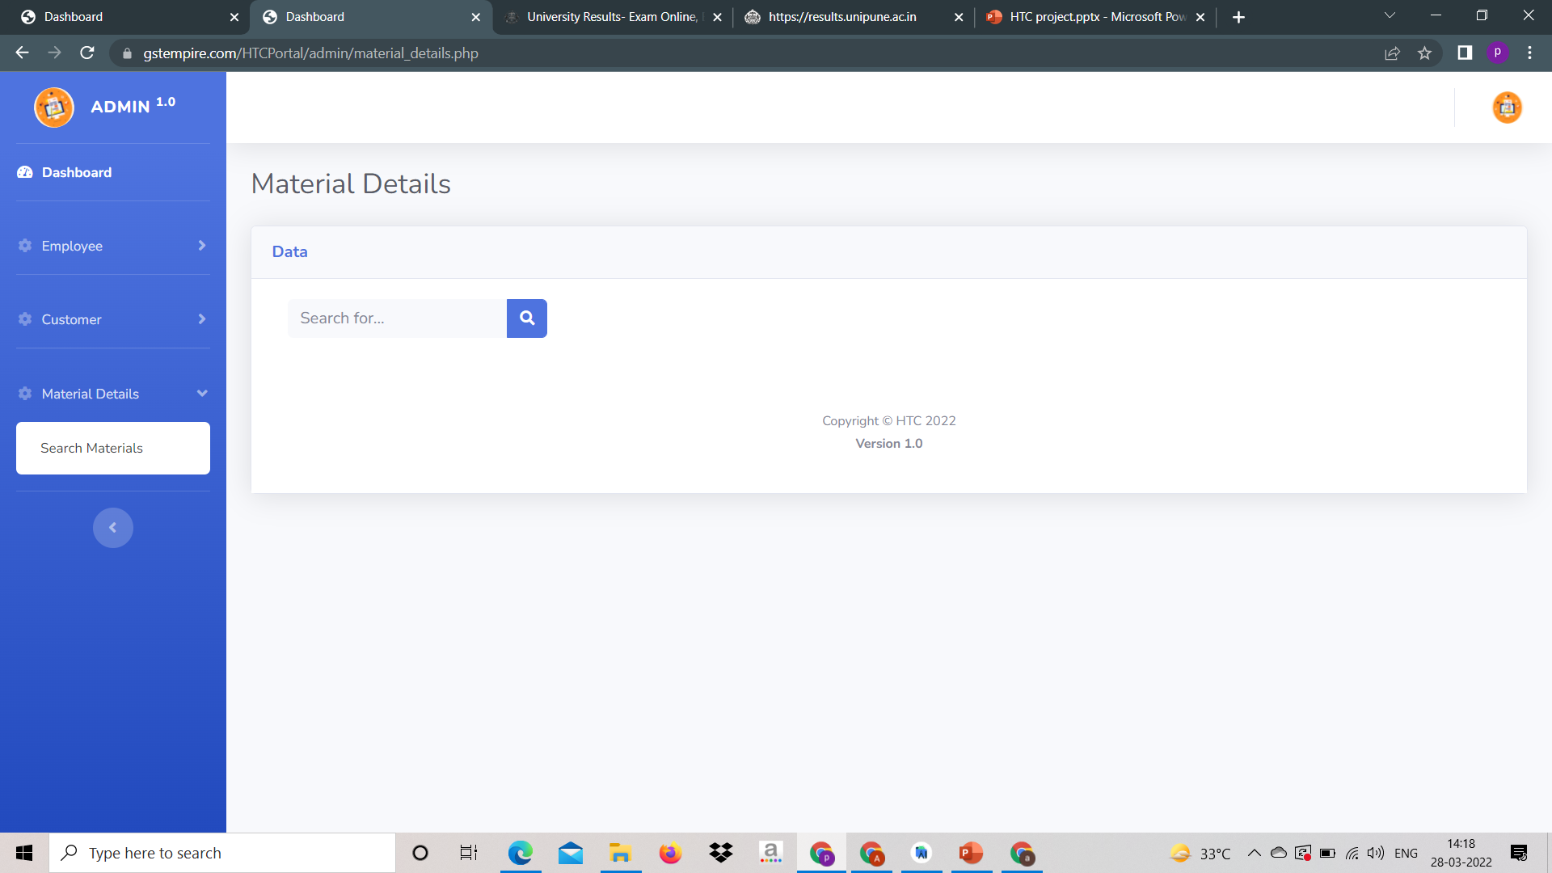
Material details

Slide 26
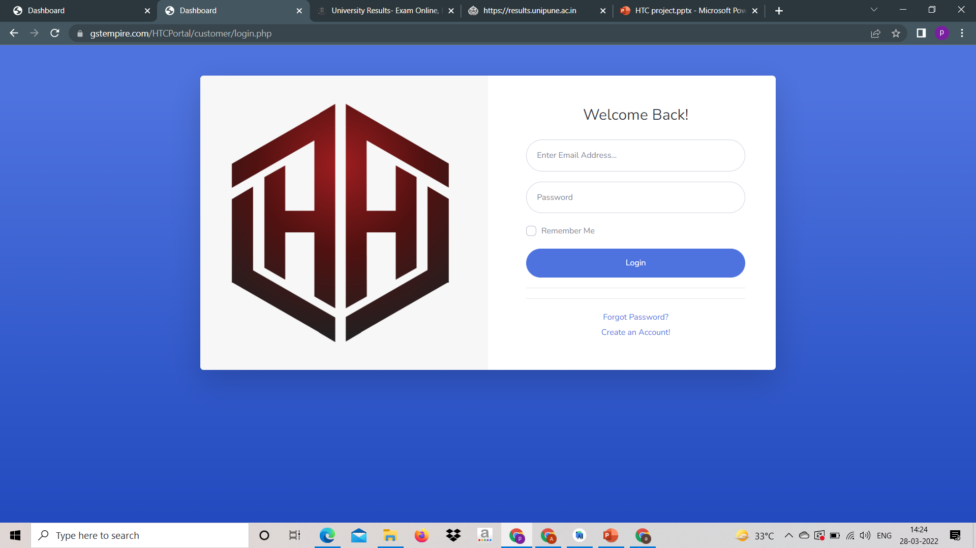
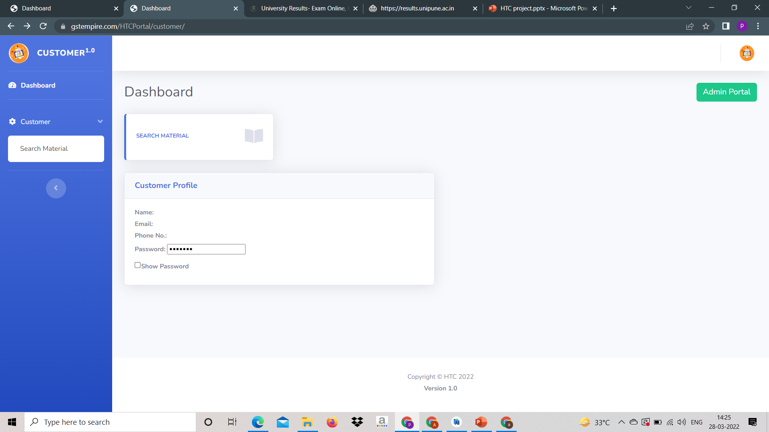
Customer Login
Customer login
Customer Dashboard

Slide 27
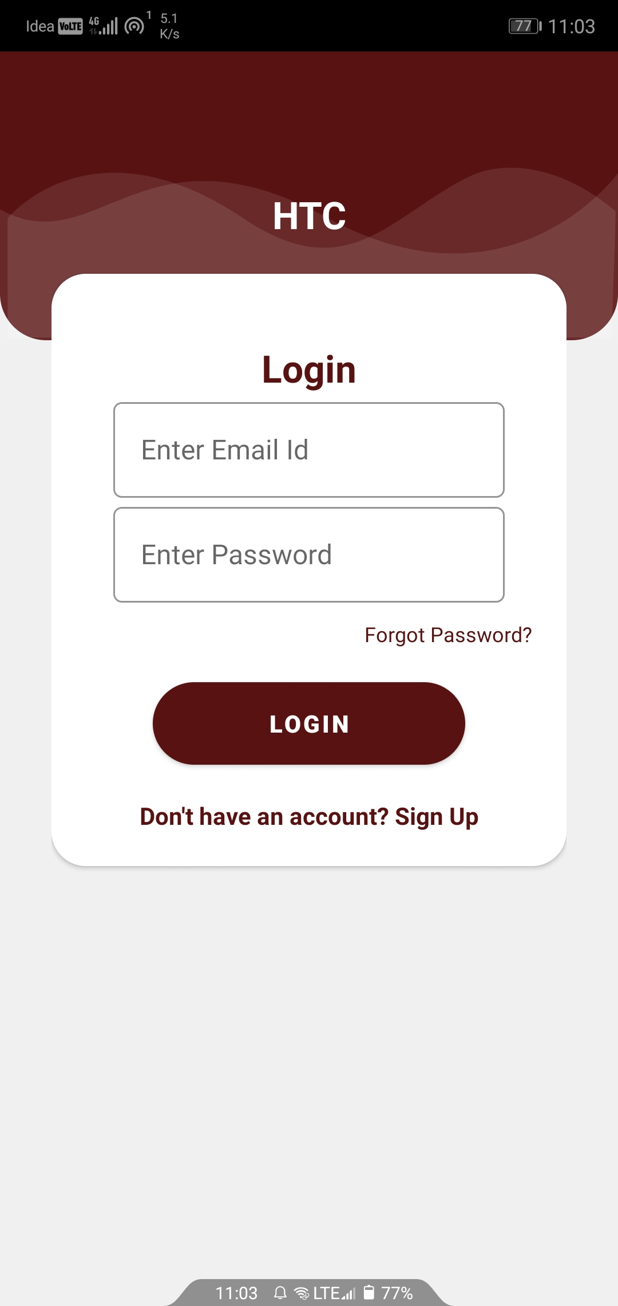
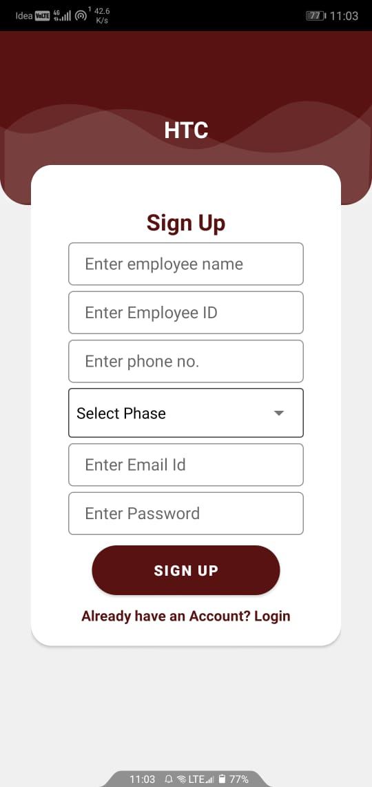
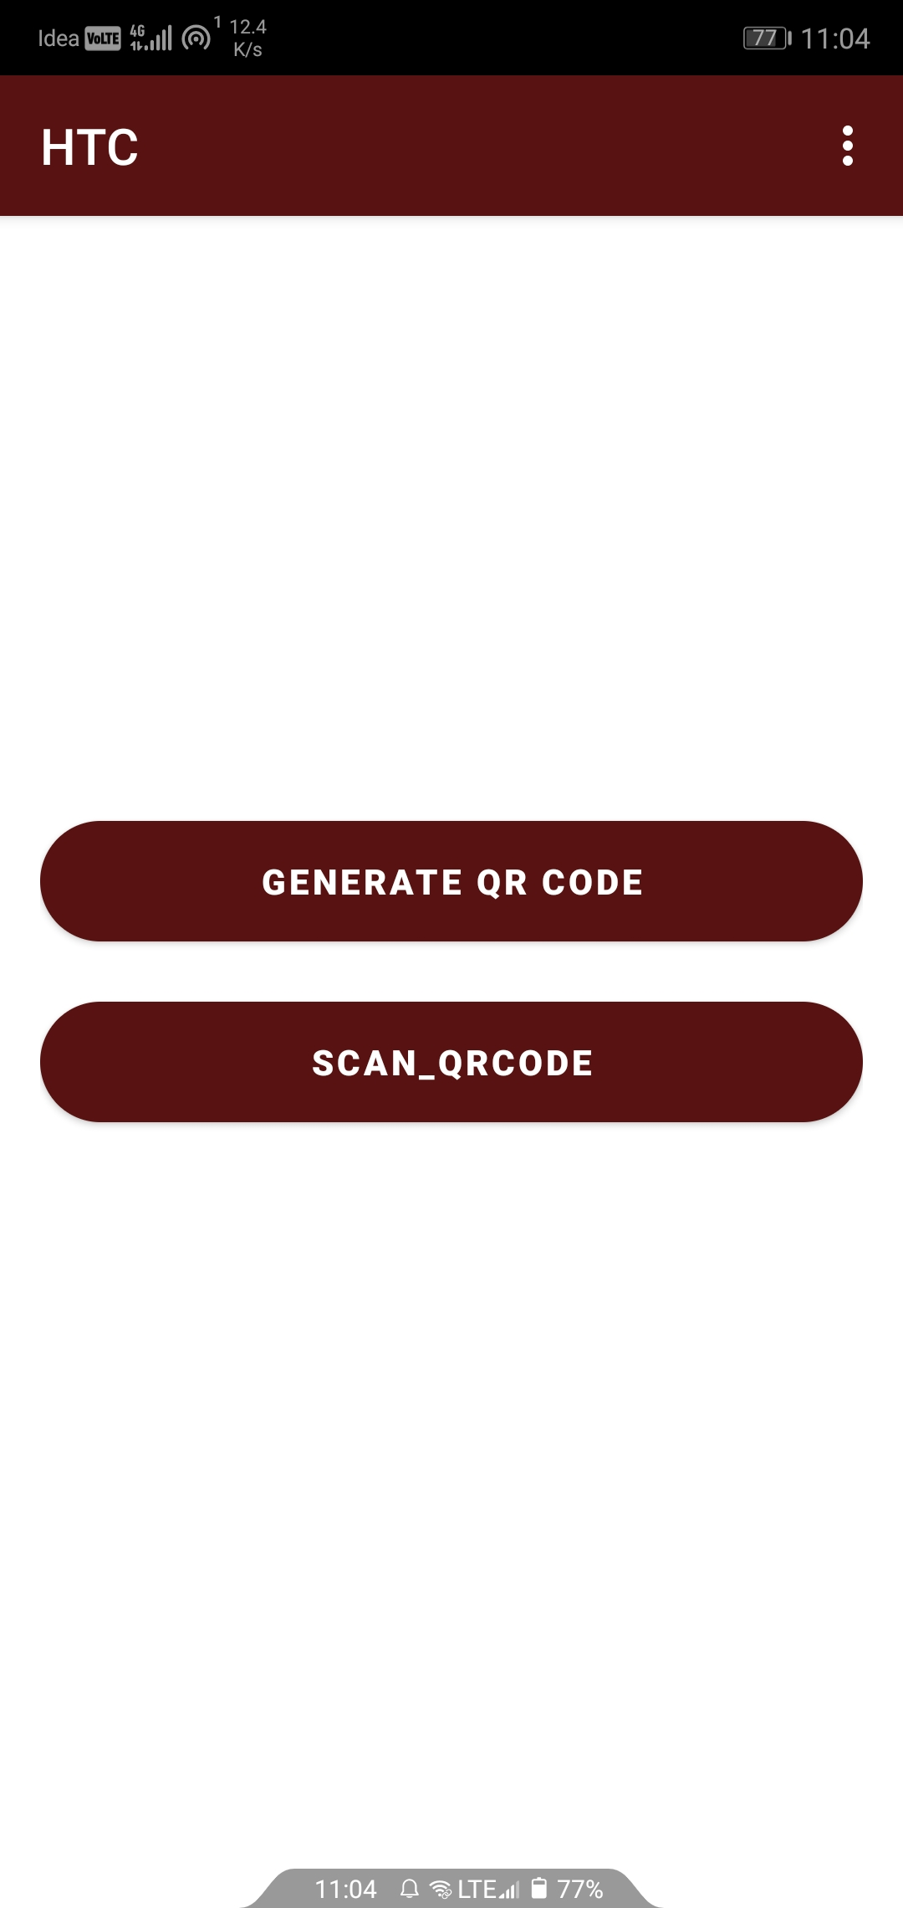
Employee Login System
Next
Next
Employee
Login
Create New Account
Generate QR Code &
Scan QR Code

Slide 28
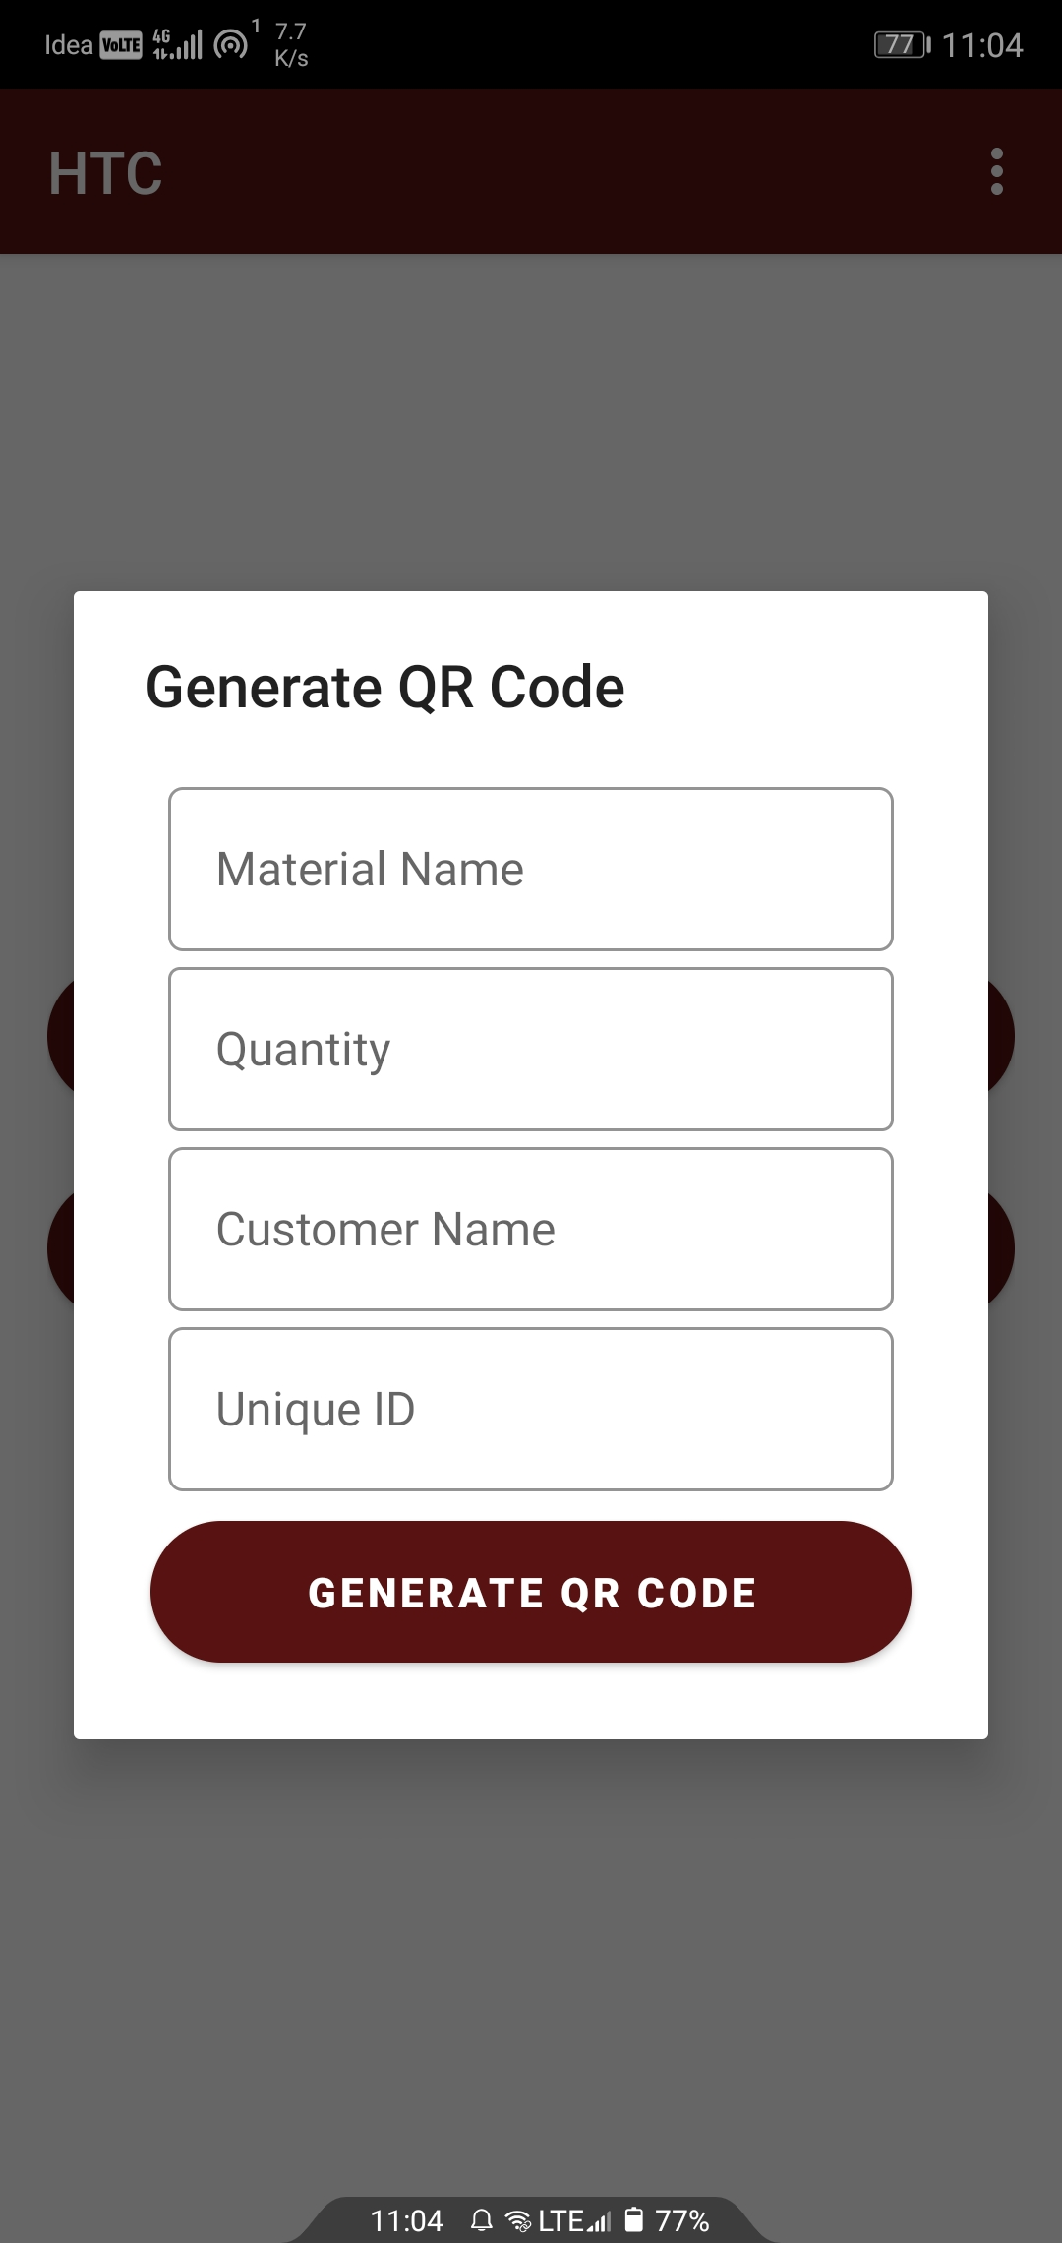
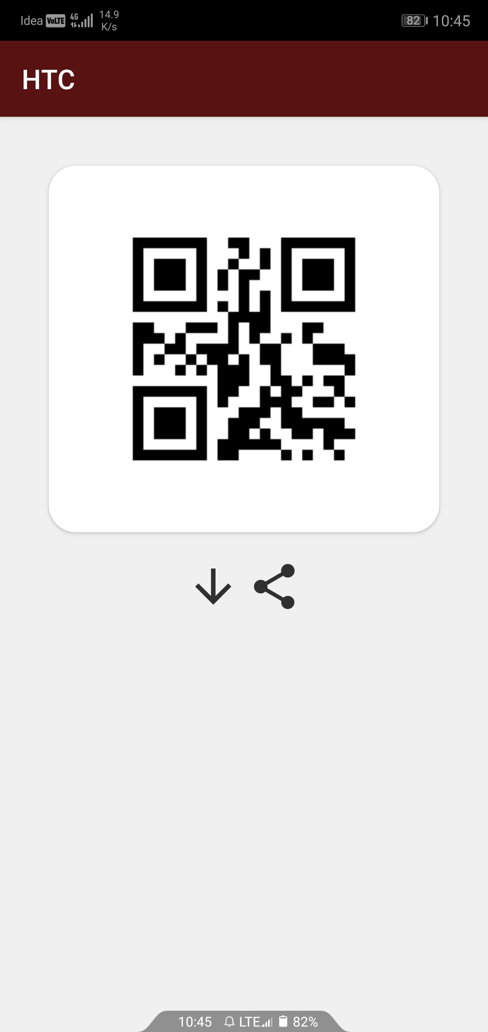
Next
Next
Enter Material
Information
QR Code

Slide 29
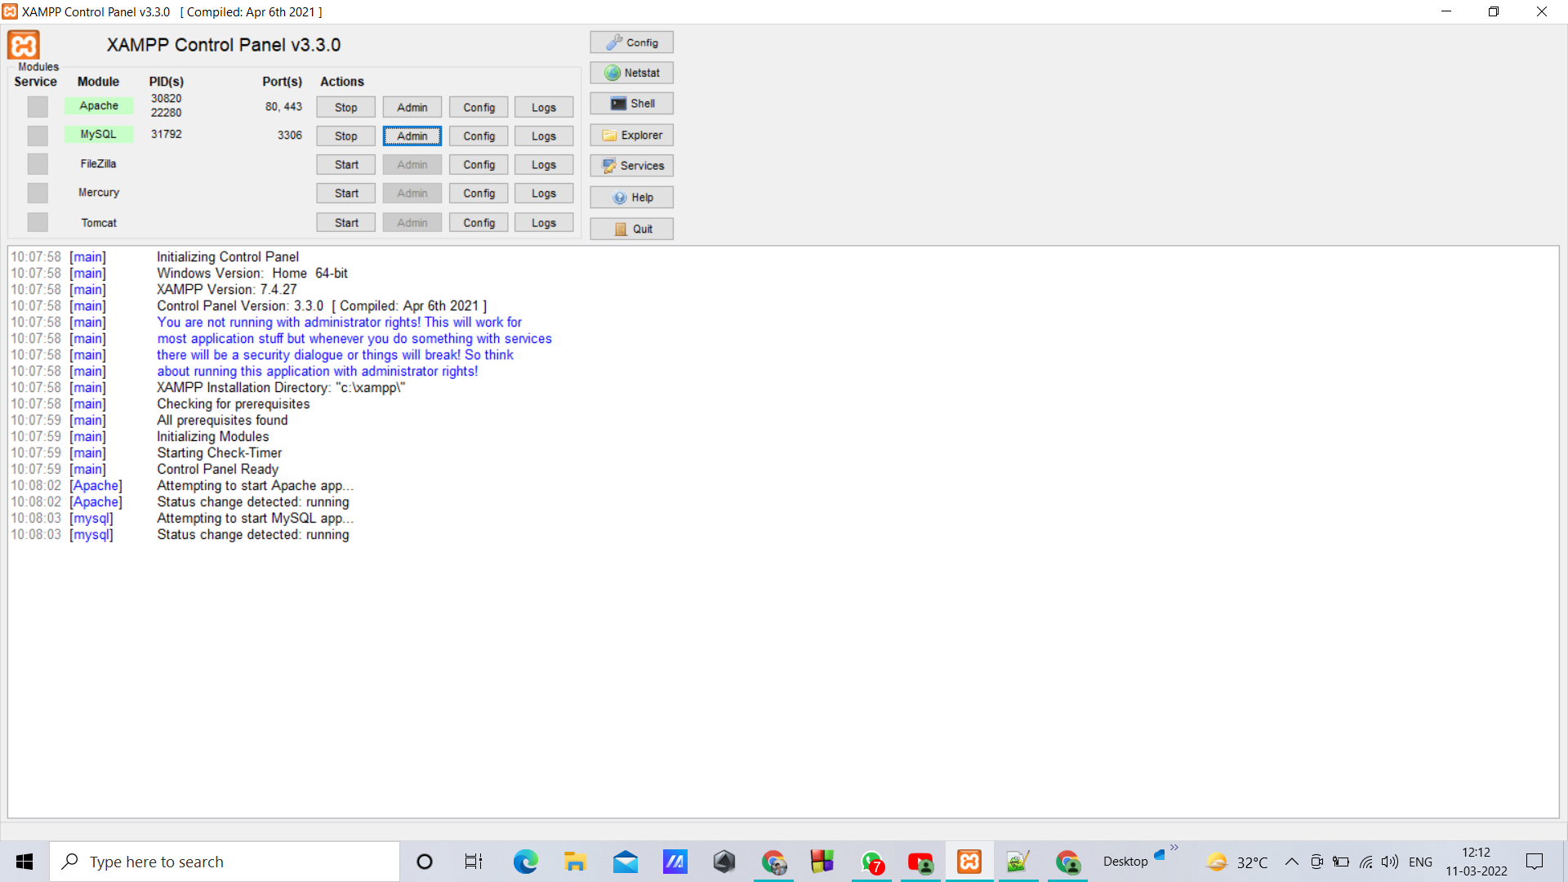
Xampp Server

Slide 30
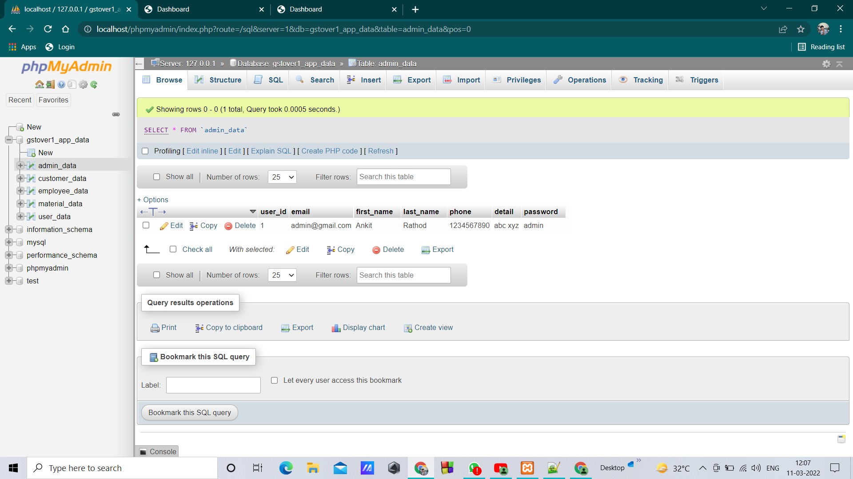
Local Host Database

Slide 31
Conclusion:
As our task is content based, and it's an ongoing issue, and this kind of framework isn't assemble yet for specific organization. So it's an ongoing solver which has an elements like it is reasonable by everybody and it is easy to use .
We are selecting RSA algorithm comparing with ECDSA and LSB algorithm.
As of now we are working on 3rd module and 2nd module are completed.

Slide 32
References:
Songdi Qian, Operation Research (revision). Beijing: Tsinghua University Press, 2020.
Detong. Zhu, Operation Research. Shanghai: Shanghai People Press, 2020.
M. Al-Zubaidie, Z. Zhongwei, and J. Zhang, “Efficient and secure ECDSA algorithm and its applications: a survey,” arXiv preprint arXiv:1902.10313, 2019.
Sahu AK, Swain G. Reversible image steganography using dual-layer LSB matching. Sensing and Imaging. 2020 Dec;21(1):1-21.

Slide 33
Thank You

